Slide 1

School of Technology, Design and Computer Application
Bachelor of Technology
Department of Computer Engineering (04)
SUBJECT: Innovation and Design Thinking(2)
Smart Hospital Resource & Appointment Management System
Group Members :-
Rensi-60(En.No:-2502030430086)
Bansi-06(En.No:-2502030430031)
Hitaxi-30(En.No:-2502030430055)
Kokay-81(En.No:-2502030430108)
Kinjal-19(En.No:-2502030430044)
Tirth-73(En.No:-2502030430100)
Internal Faculty Guide
Prof. Kruti Sheth

Slide 2
Table of Content
Abstract | Prototype Screenshot
Introduction | Problem
Literature Survey/Research | Solution
Proposed Work | Novelty of definition
AEIOU Canvas | Worked carried out till date(Table format)
Ideation Canvas | Future Work, Conclusion & References

Slide 3
Abstract
The project “Smart Hospital Resource & Appointment Management System
” focuses on improving hospital and patient management using online technology.
It helps patients easily check bed availability, doctor timing, and appointment status from their mobile phones.
The system gives real-time updates to avoid long waiting hours and make hospital operations more efficient.

Slide 4
Introduction
In today’s world, managing healthcare efficiently is very important.
Many hospitals still use manual systems for patient entry and updates.
This causes problems like waiting in lines, lack of communication, and delayed updates.
Our system focuses on digitalizing healthcare services to improve patient convenience and hospital management.

Slide 5
Literature Survey/Research
Sr. No. | Title / Research Work | Technology Used | Key Findings / Outcome
1. | IoT-Based Smart Healthcare System | IoT, Cloud | Real-time health data collection using sensors and remote monitoring of patients.
2. | Online Hospital Management System | Web, Database | Simplifies hospital operations like appointments, billing, and bed management.
3. | Doctor Appointment & Scheduling Portal | Android, PHP, MySQL | Helps patients book and track doctor appointments online, reducing waiting time.

Slide 6
Proposed Work
Develop an online system to show live bed availability, doctor timings, and patient queue status.
Patients can check updates easily on their mobile phones.
Hospital staff can update information instantly through an admin panel.
Helps reduce waiting time, manage crowds, and improve hospital communication.

Slide 7
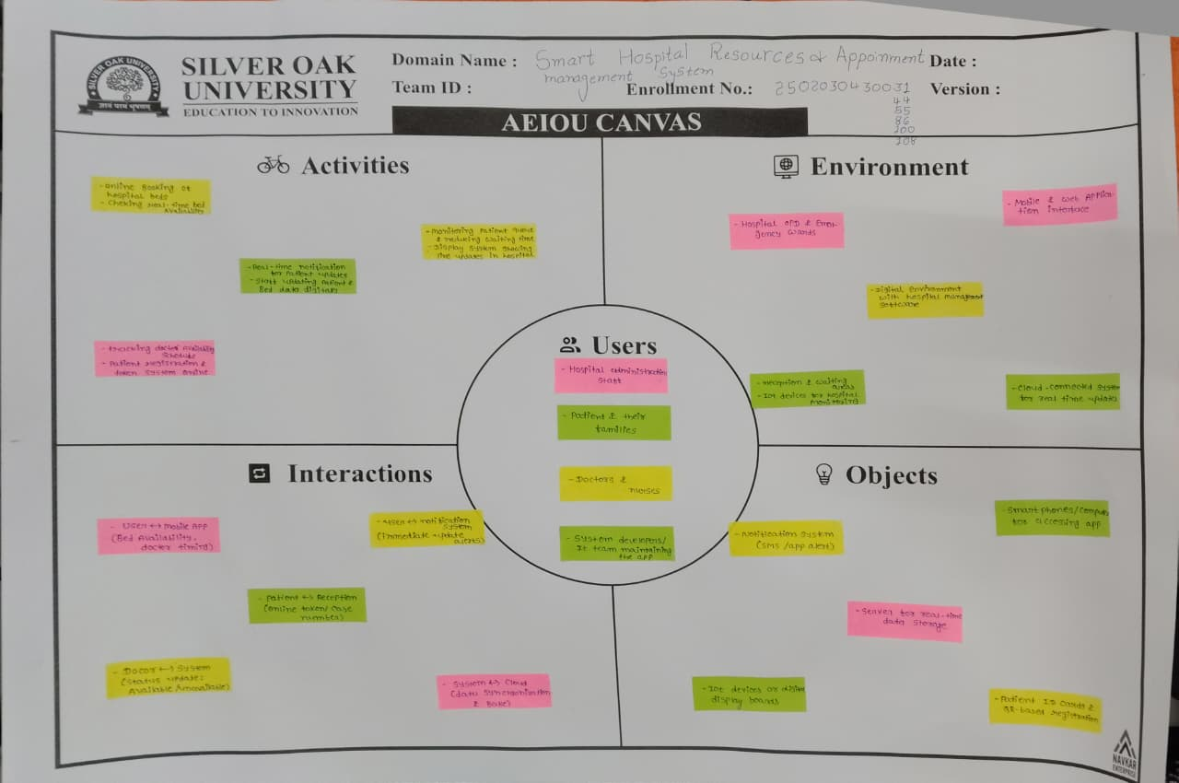
AEIOU Canvas

Slide 8
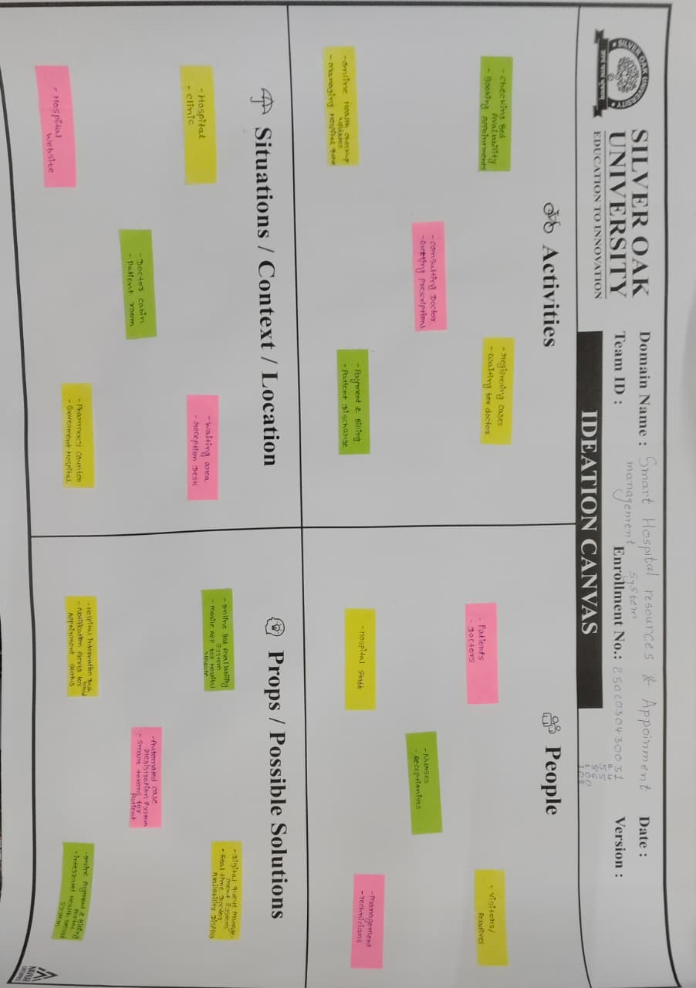
Ideation Canvas

Slide 9
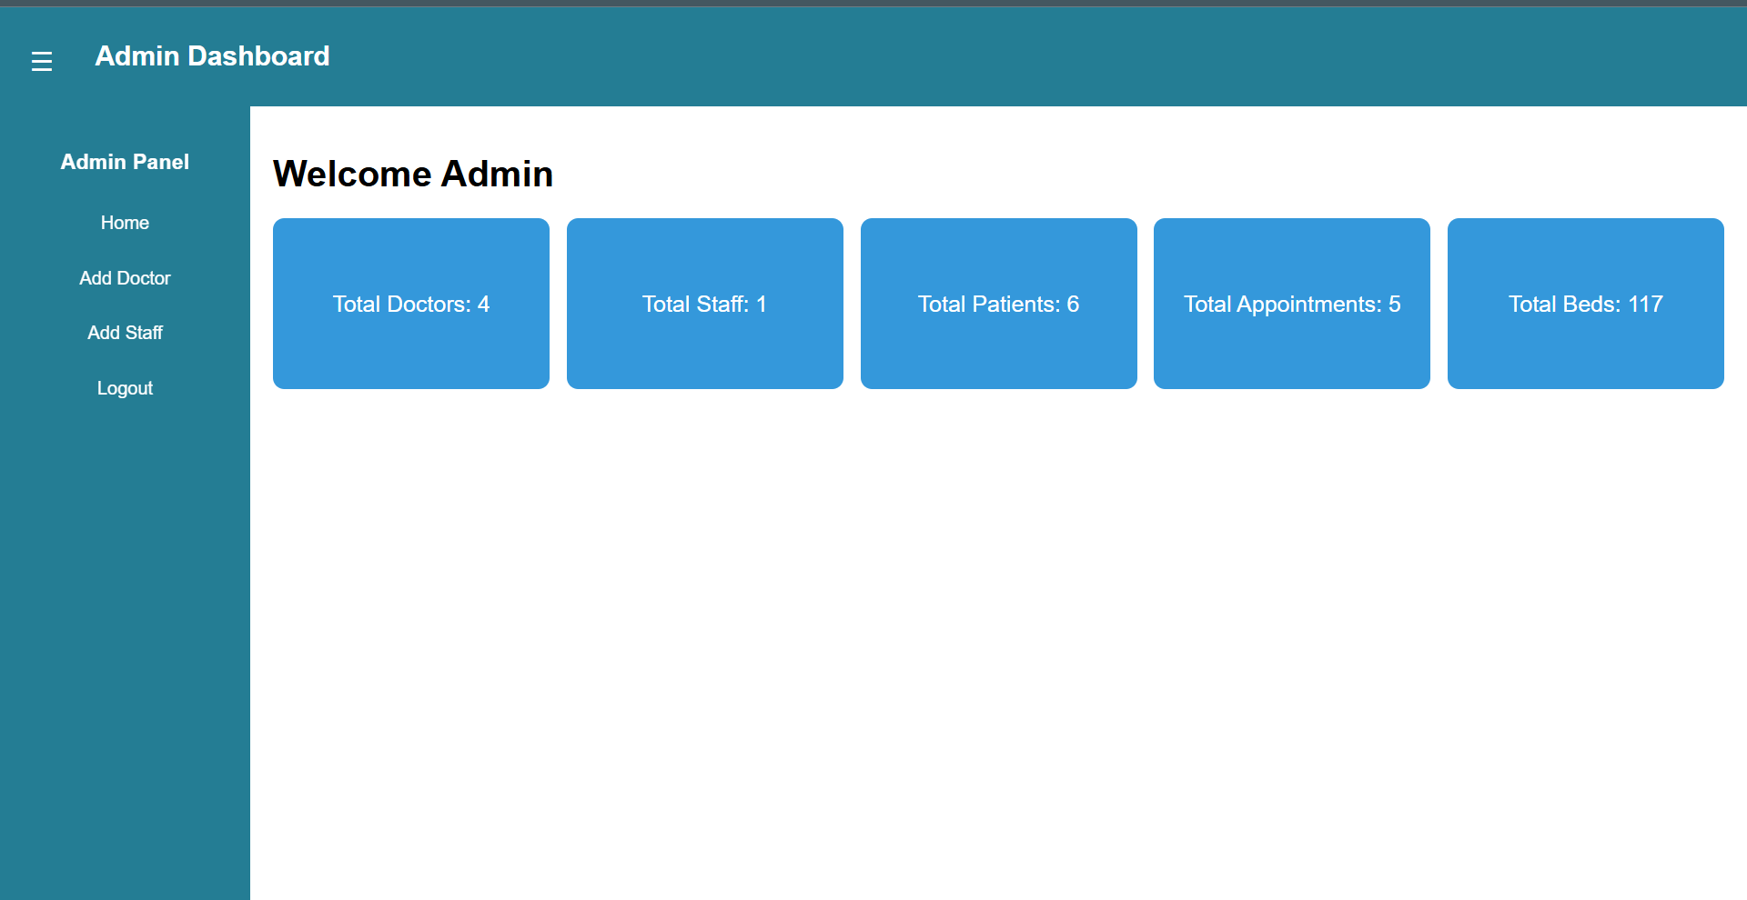

Slide 10
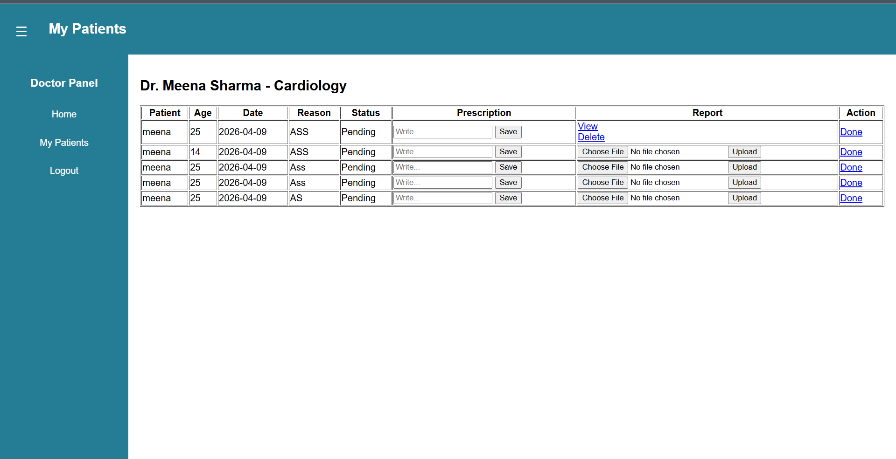

Slide 11
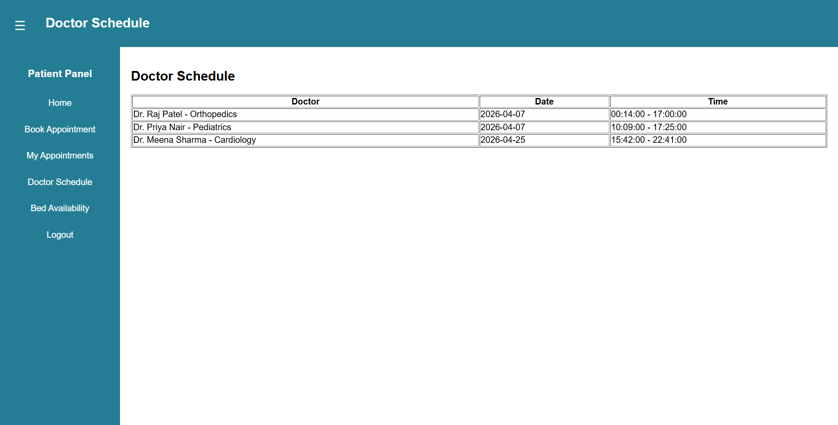

Slide 12
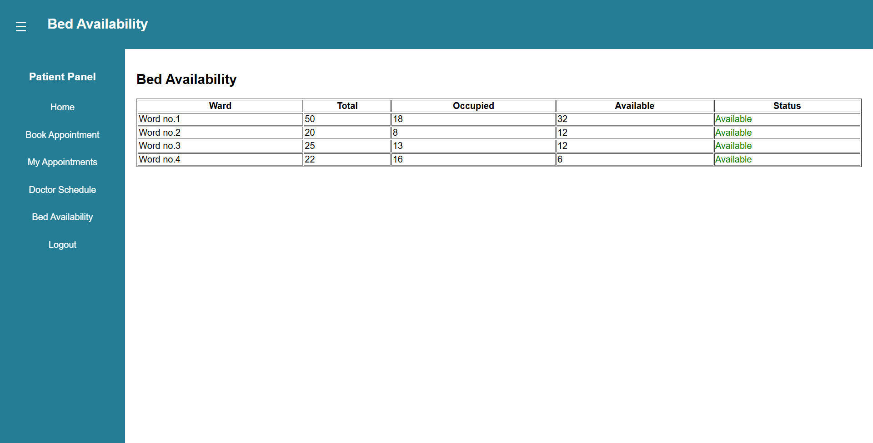

Slide 13
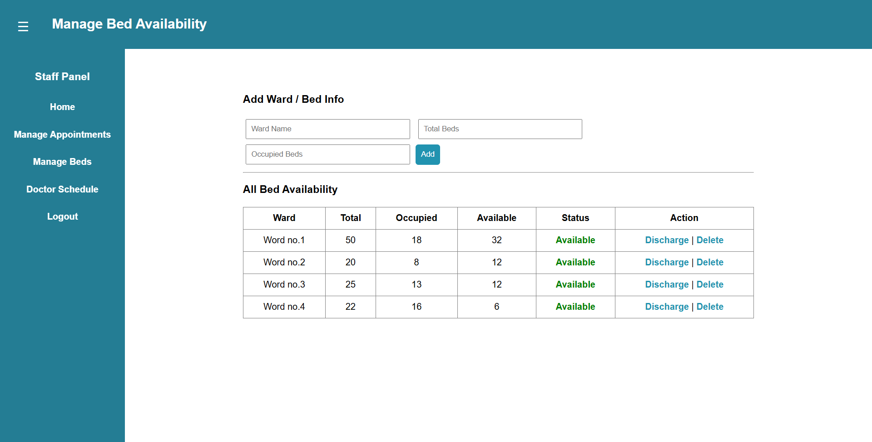

Slide 14
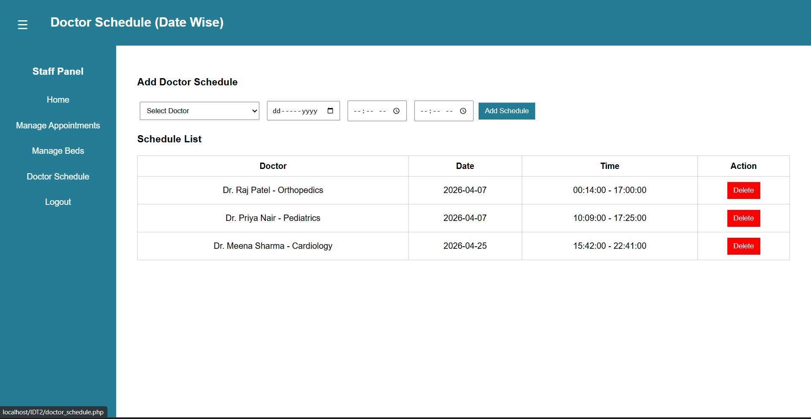

Slide 15
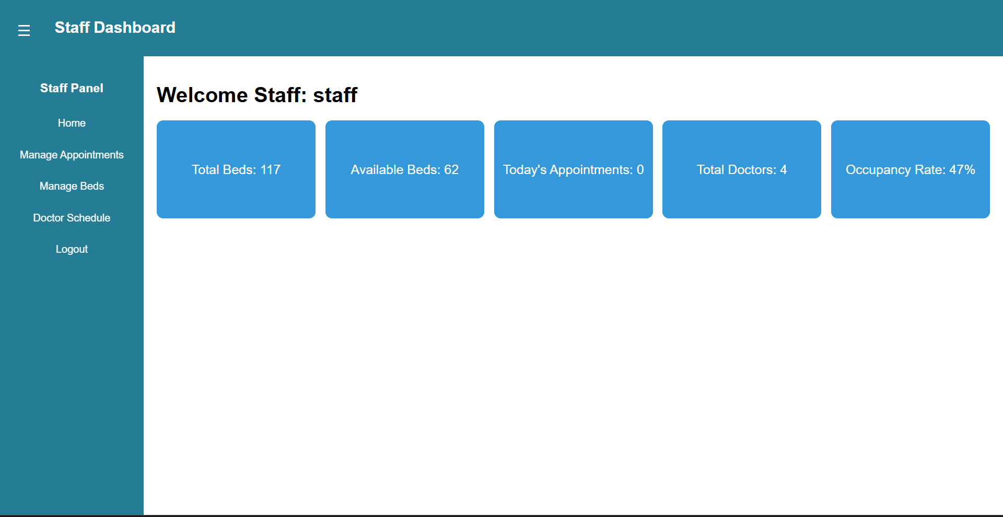

Slide 16
Problem
Bed Availability: Patients do not know if beds are available in hospitals until they visit physically.
Long Waiting Queues: Patients have to stand outside the hospital for a long time to get their case number or appointment.
Doctor Availability: Patients are not informed about which doctors are present or when they will arrive.
No Real-time Updates: There is no system to give immediate updates about hospital changes or doctor schedules.

Slide 17
Novelty of Definition
Provides real-time hospital data directly on mobile phones.
Combines doctor timing, bed info, and patient queue in one platform.
Uses automatic updates and notifications for patients and staff.
Improves both healthcare access and wellness experience for users.

Slide 18
Solution
Develop an online healthcare management system that shows:
Live bed status on a mobile app or website.
Doctor’s schedule and availability in real time.
Digital queue system for patients to take tokens online.
Instant notifications for any update or change in hospital information.
Helps reduce waiting time and improve hospital transparency.

Slide 19
Work carried out till date
Work Done | Description | Status
Problem Analysis | Studied issues in hospital management | Completed
Design Phase | Planned layout for mobile/web system | Completed
Prototype | Created demo for bed & doctor updates | In Progress
Testing | Collecting sample data for testing | Pending

Slide 20
Future Work & Conclusion
Future Work:
Add features like online appointment booking and patient report tracking.
Connect multiple hospitals to one platform for better reach.
Include AI suggestions for patient wellness and health tips.
Conclusion:
The system helps hospitals and patients stay connected in real time.
It reduces crowding, saves time, and ensures better communication.
A small step toward smart, digital healthcare and wellness.

Slide 21
References
Oracle Java Documentation – Exception Handling
Java: The Complete Reference – Herbert Schildt
Java How to Program – Paul Deitel & Harvey Deitel
Exception Handling in Java – GeeksforGeeks
Java Exception Handling Tutorial – TutorialsPoint
Unified Modeling Language (UML) Documentation – Object Management Group

Slide 22
Thank you

